Slide 1
Group 9 - Web Application
Gregor Davis - DJ Dorren - William Wilson - Kiara Uniacc - Mohsin Ahmed

Slide 2
Target Market
The target market of our web application is a user of any age who is interested in reducing their carbon footprint and looking after our planet.
Any Age
Eco Friendly Minded
Lives in Dundee

Slide 3
Why is this something that should be developed
In 2019 it is becoming ever more important that we begin to look after our planet. This application is a good way to get more people interested and to highlight what small things people can do to help our planet.
Get more people interested in the Eco problem
Make it easy for people to make small changes

Slide 4
The projects main innovation
Our projects main innovation is our recipe page.
It provides many easy recipes and the ingredients required to make simple meals that are good for our planet and your body.

Slide 5

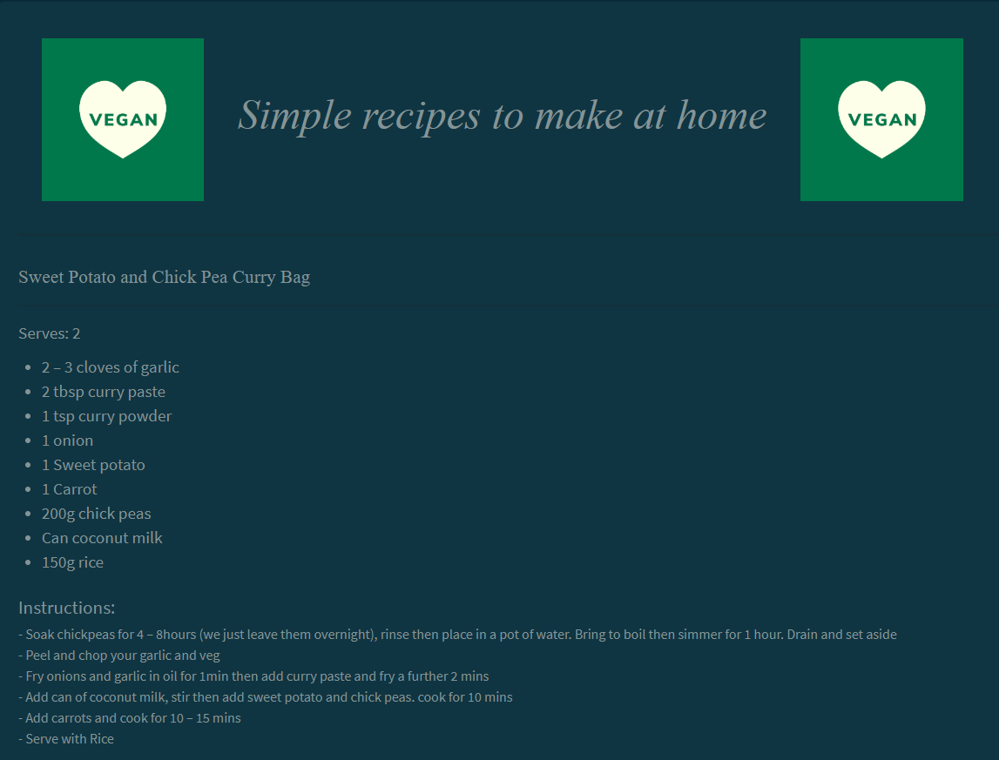
Navigation
Recipe Page
It is very simple to get around our
application, our navigation bar is clean and immediately obvious how to use
The Recipe Page is very clean looking and
provides many simple recipes to follow

Slide 6
Live Demonstration
We will now move onto our live demonstration

